Slide 1
TALLINT

Slide 2
Recruiter’s Core Module
Centralized database to all recruiters
Resumes sourced by each recruiter from all portals and channels in one centralized location for all recruiters to access
Auto Parser, Auto De-Duplication, traceable candidate history
Advanced search and shortlisting of candidates with real time tracking of candidate status
Ready plugin to Outlook to trigger auto mailers/templatized communications to candidates and all stakeholders
Dashboards to plug gaps and increase efficiency
Configurable workflows, highly secure data, user friendly and scalable system

Slide 3
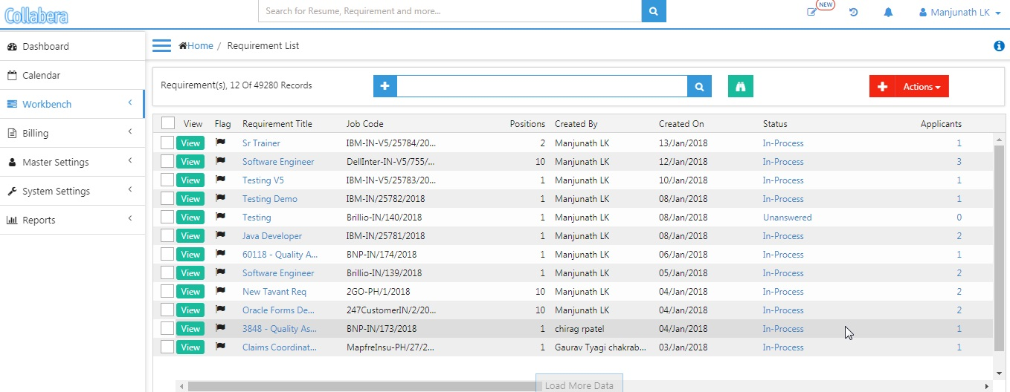
Requisitions Tracker View/Reports

Slide 4
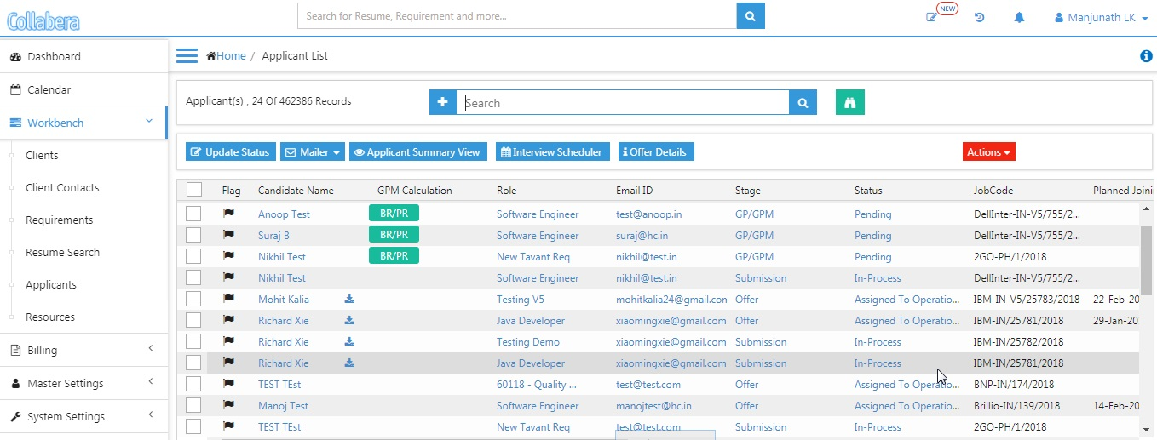
Applicants Tracker View/Reports

Slide 5
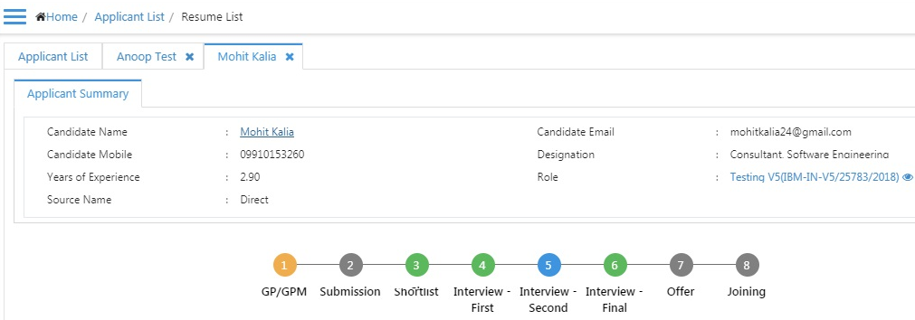
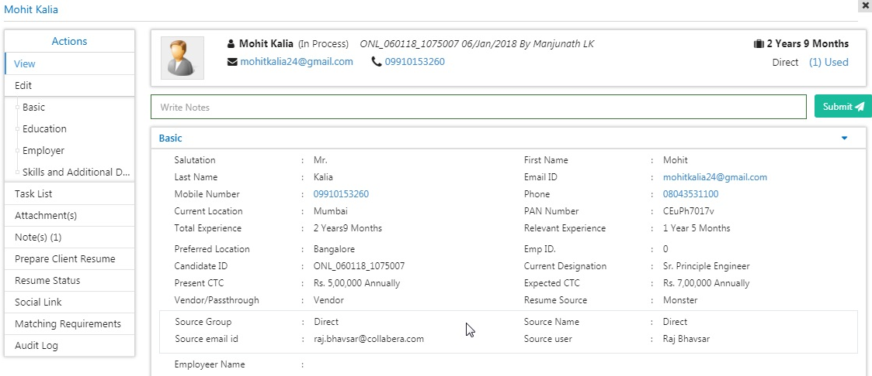
Candidate Profile View

Slide 6
Resume Upload and Screening: Easy tracking, better TAT
Easy upload of resumes into HireCraft: Single Database to all recruiters
Bulk uploads: Folder upload, Excel upload
Upload resumes from Outlook attachments: through plugin
Automation: Career Portal, Employee Referral Portal and Vendor Portal submissions auto uploaded into HireCraft and tagged to applied requisitions (Add-on portals).
Easy search of resumes by recruiters
Advanced search filters (based on keywords, Boolean search, skills, experience, previous tagged requirements etc.) – Fast & Accurate! No sourcing challenges!
Building/Managing own database, reduces cost of sourcing from Portals/Vendors.
Submission resumes and shortlisting through line managers

Slide 7
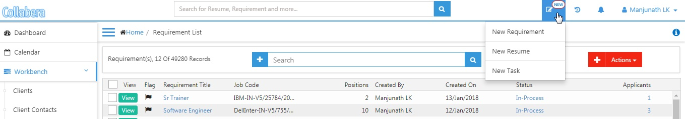
Single Parsing:
Click on ‘New’
“Single resume” at a time which has been saved in his/her system/drive into HireCraft V5 application and they are automatically filled into respective fields

Slide 8
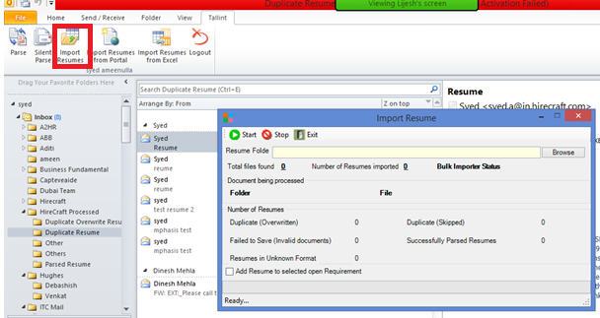
Bulk Parsing:
More than one resumes can be parsed into Hirecraft V5 application. For parsing resumes saved in a Folder on your computer, you can use Bulk Resume Import feature to parse and save more than one resume at a time.

Slide 9
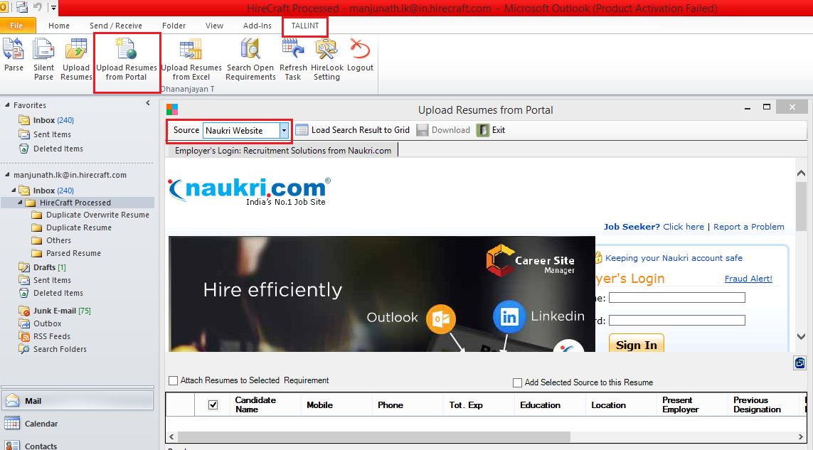
Import from Portals:

Slide 10
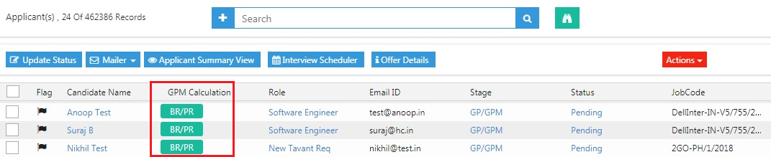
BR/PR for GP/GPM Calculation

Slide 11
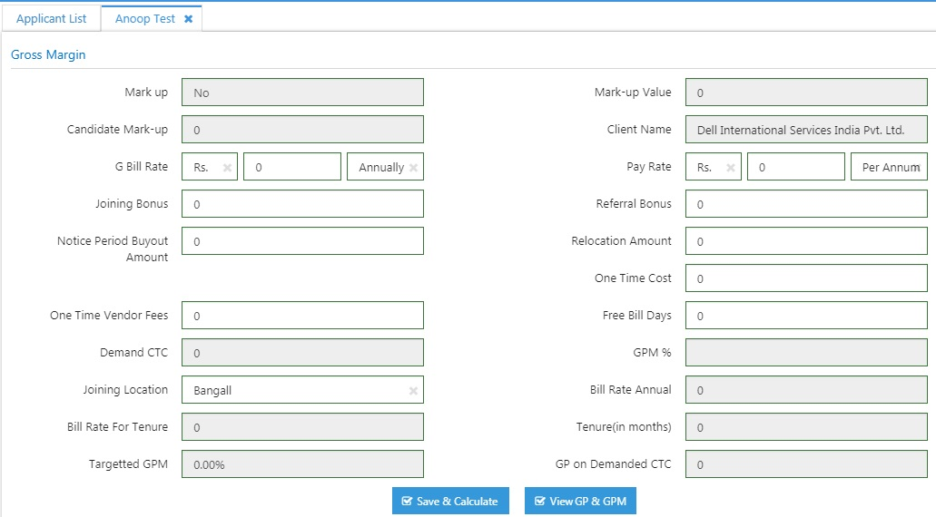
Continue..

Slide 12
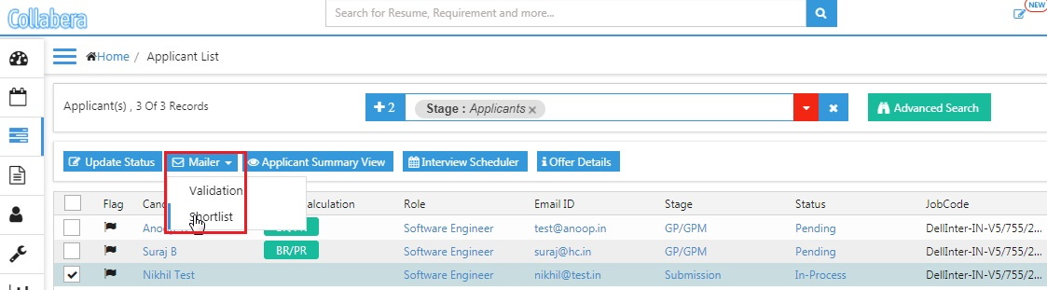
Notification Mailer to Candidates and HM

Slide 13
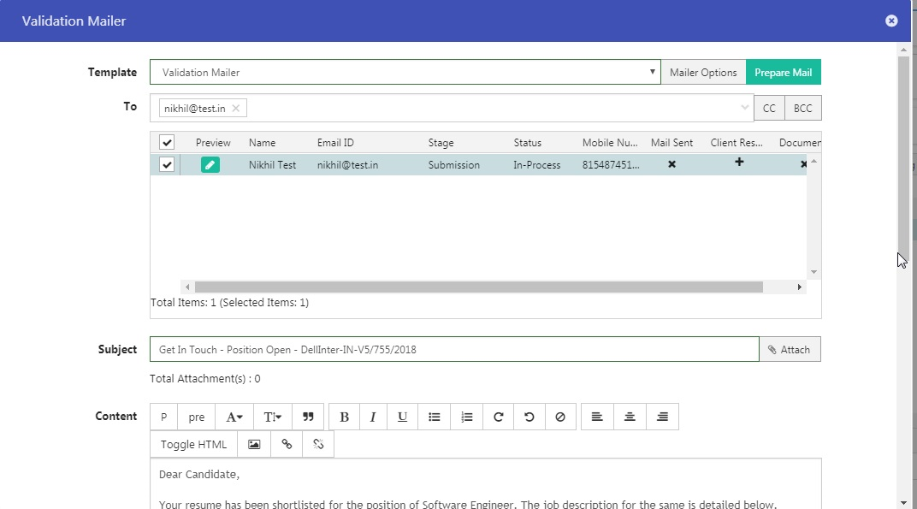
Continue..

Slide 14
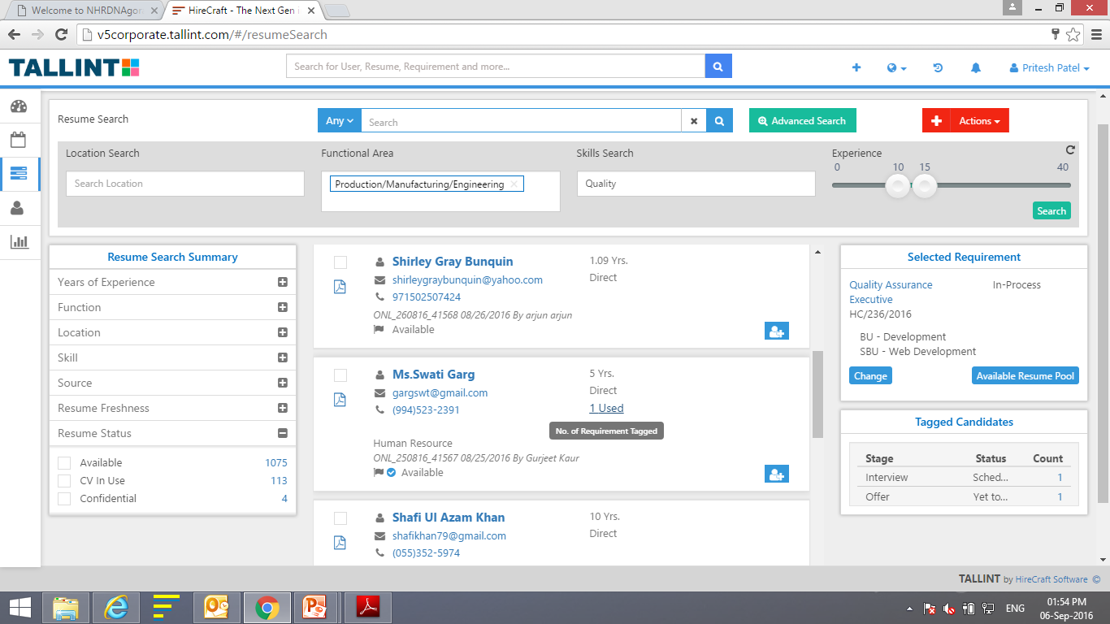
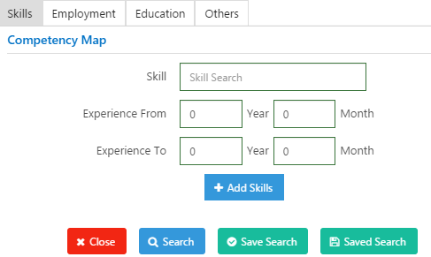
Resume Search
Advanced Search

Slide 15
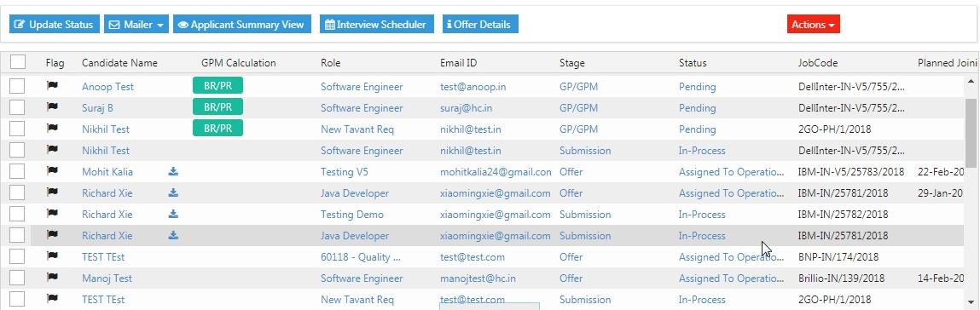
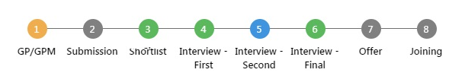
Submission, Short listing and Tracking
Recruiter Module
Candidate Status Tracker

Slide 16
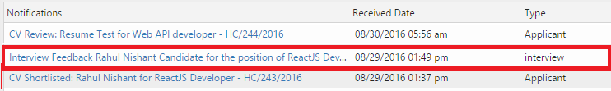
Interview Management
Scheduling Interview is now more organised and better coordinated
Set the date, time, venue, interview panel, feedback questionnaire template etc), let HireCraft do the emailing and reminders
Interviewers notified on their Line Manager portal (HireCraft Add-on portal) with interview details, feedback questionnaire and candidate CV
Interviewer feedback ported to Recruiters in real time even before candidate walks out. No more tracking emails or waiting for feedbacks scribbled on CV hard copy. Faster TAT.
Employees, Vendors and candidates are notified over emails and through respective portals (HireCraft add-ons) regarding interview status
Scheduled, qualified, rejected, on-hold, rescheduled etc

Slide 17
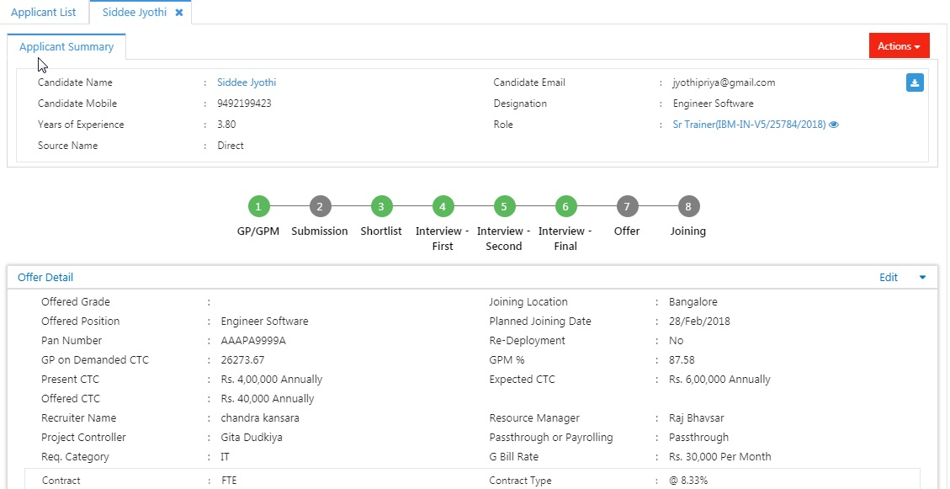
Offer and On-Boarding Automated
Offer Manager:
HireCraft automates the offer break up as per salary headers, based on fitment scale (grade, location, CTC range etc.)
Offer Approval by relevant approving authority can be triggered
Offer letter auto generated as per client templates
Standardized and accurate offers rolled out in shortest TAT

Slide 18
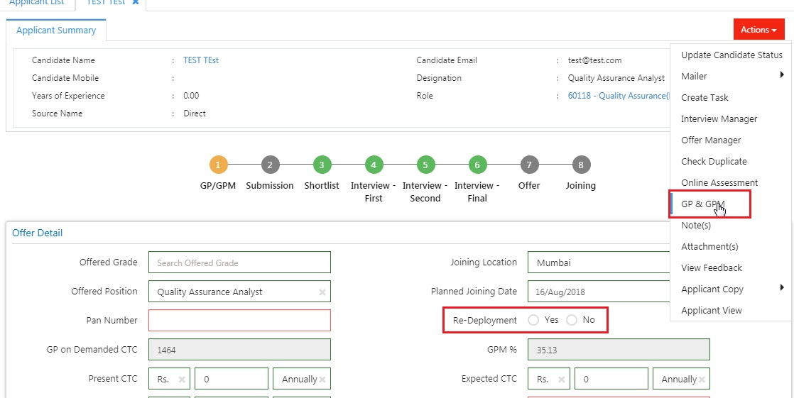
Re-Deployment Offer and BR/PR

Slide 19
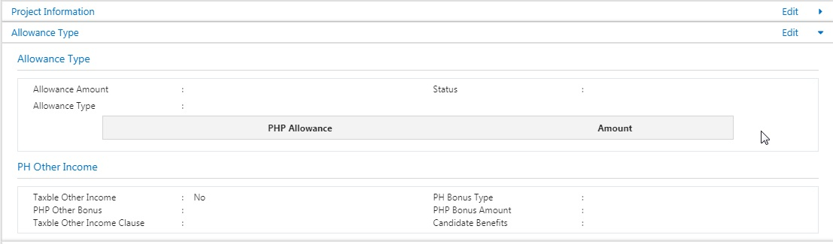
Offer Geo for Philippines Overview Layout

Slide 20
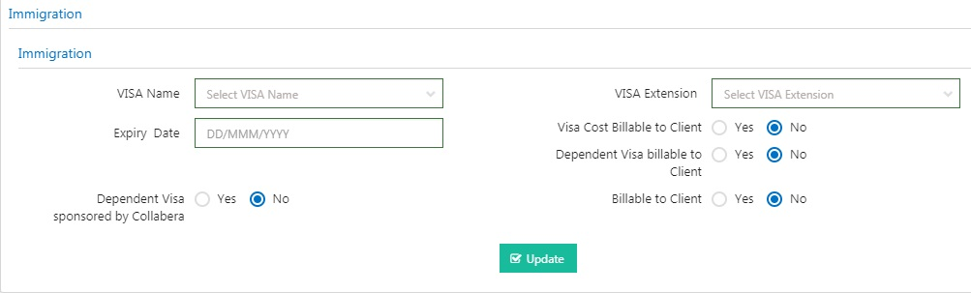
Offer Geo for Singapore/Malaysia Overview Layout

Slide 21
Thank you

